Slide 1

Value of Assistance for Mobile Robots
IROS 2023
Adi Amuzig, David Dovrat and Sarah Keren

Slide 2
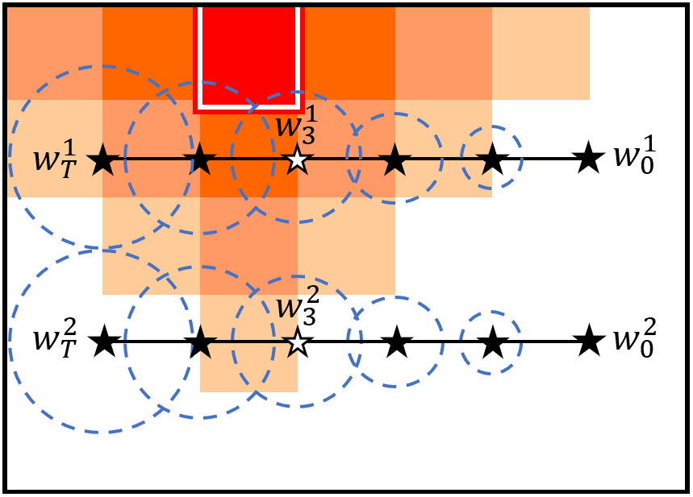
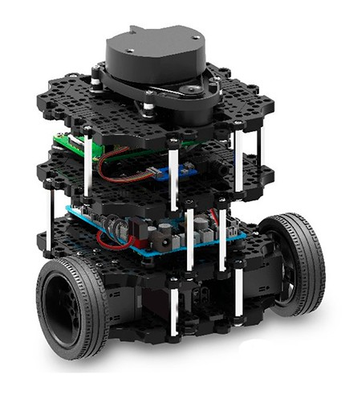
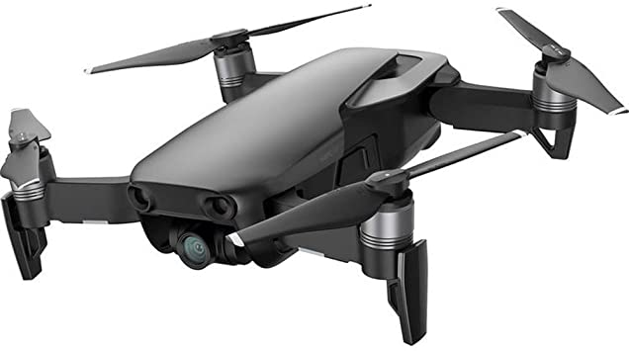
Value of Assistance for Mobile Agents
To which agent would the assistance be more valuable?
Notes:
Talk about what the orage means. It is the danger zone

Slide 3
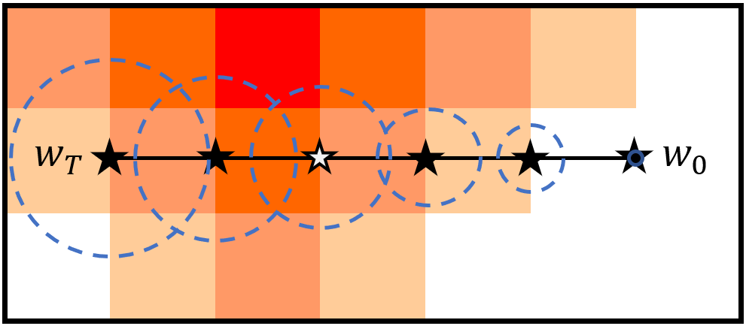
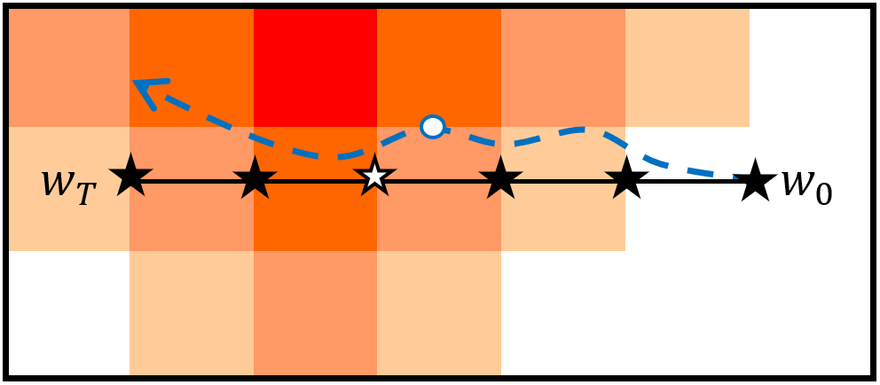

Assumptions
Agent must follow a pre-computed path with no external sensors of the environment
Location uncertainty modeled as a Gaussian process
$$X\left(τ\right)\sim N\left(Π^{P}\left(τ\right), Σ\left(Π^{P}\left(τ\right),τ\right)\right)$$
The expected accumulated cost for an agent to follow path $Π^{P}$from $τ_{0}$to $τ_{1}$ on a given cost map $M$ can be computed as follows
$$C_{τ_{0}}^{τ_{1}}\left(Π^{P}\right)=\int_{τ_{0}}^{τ_{1}}{\int_{ℝ^{n}}{P\left(X\left(t\right)=x\right)M\left(x\right)dx}dt}$$
Total expected cost for following the entire path $Π^{P}$ from $0$to $1$ is
$$C\left(Π^{P}\right)=C_{0}^{1}\left(Π^{P}\right)$$
Notes:
Say that $τ∈\left[0,1\right]$

Slide 4
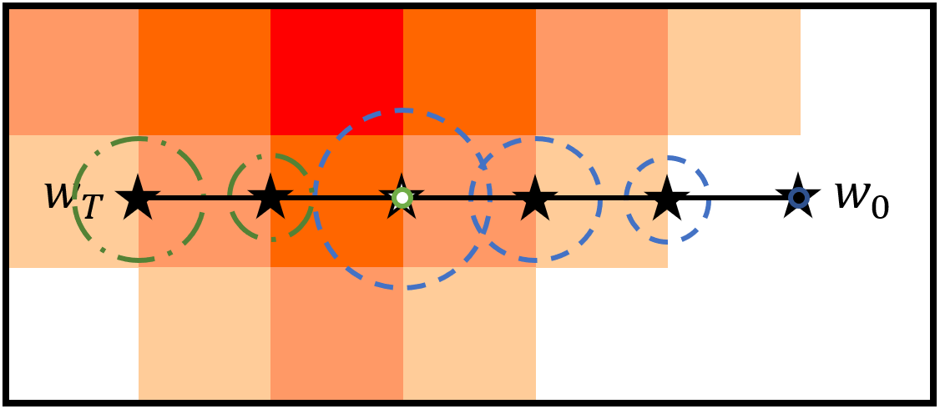
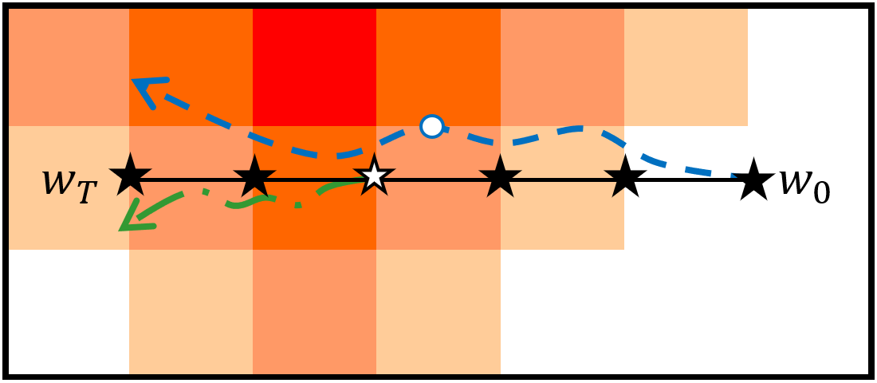

Relocation Assistance Computing VOA
The total expected cost of executing $Π_{τ}^{P}$ is
$$C\left(Π_{τ}^{P}\right)=C_{0}^{τ}\left(Π^{P}\right)+C_{τ}^{1}\left(Π_{τ}^{P}\right)$$
The total value of assistance is calculated as
$$V\left(M,Π^{P},τ\right)=C_{τ}^{1}\left(Π^{P}\right)−C_{τ}^{1}\left(Π_{τ}^{P}\right)$$
Relocation assistance estimated location uncertainty: blue – before assistance, green - after receiving assistance, black - planned path
Relocation assistance executed path: blue – without assistance, green – after receiving assistance, black - planned path

Slide 5
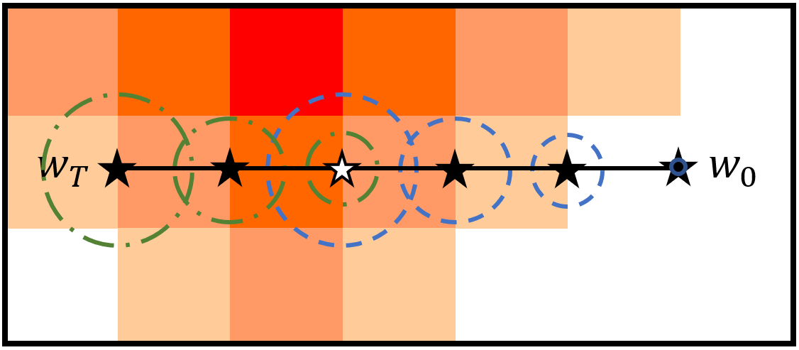
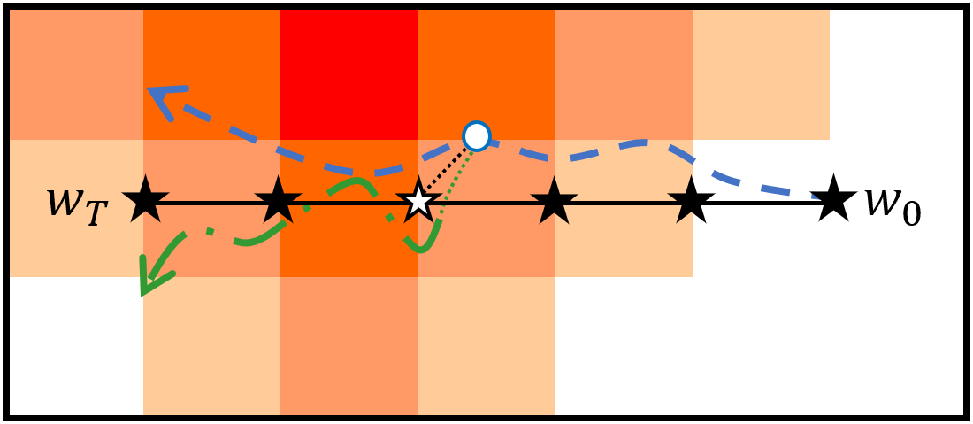

Localization Assistance Computing VOA
The total expected cost of executing $Π_{τ}^{P}$ is
$$C\left(Π_{τ}^{P}\right)=C_{0}^{τ}\left(Π^{P,1}\right)+C_{0}^{1}\left(Π^{P,2}\right)+C_{τ}^{1}\left(Π^{P,3}\right)$$
The total value of assistance is calculated as
$$V\left(M,Π^{P},τ\right)=C_{τ}^{1}\left(Π^{P}\right)−C\left(Π^{P,2}\right)−C_{τ}^{1}\left(Π^{P,3}\right)$$
Localization assistance estimated location uncertainty: blue – before assistance, green - after receiving assistance, black - corrective path
Localization assistance executed path: blue – without assistance, green – after receiving assistance, black - corrective path

Slide 6
Goals for the Empirical Evaluation
Examine the ability of our proposed VOA measures to predict the effect assistance will have on performance.
relocation and localization.
simulated and real-world robotic settings.
We compare VOA to the Average Executed Cost Difference (AECD)
Notes:
For this purpose, we compare VOA to the Average Executed Cost Difference (AECD).

Slide 7
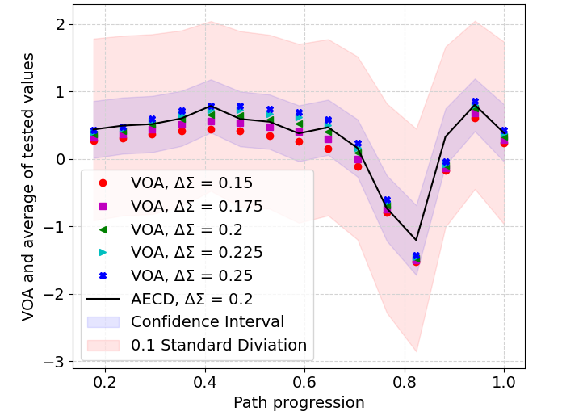
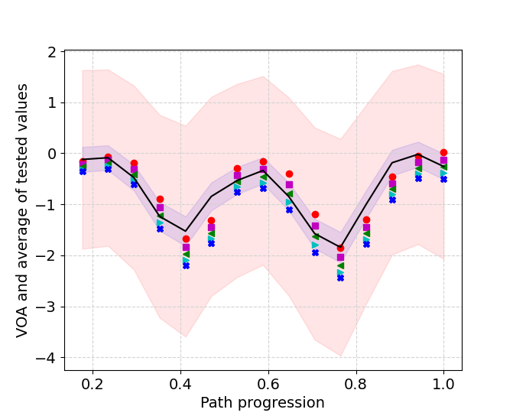
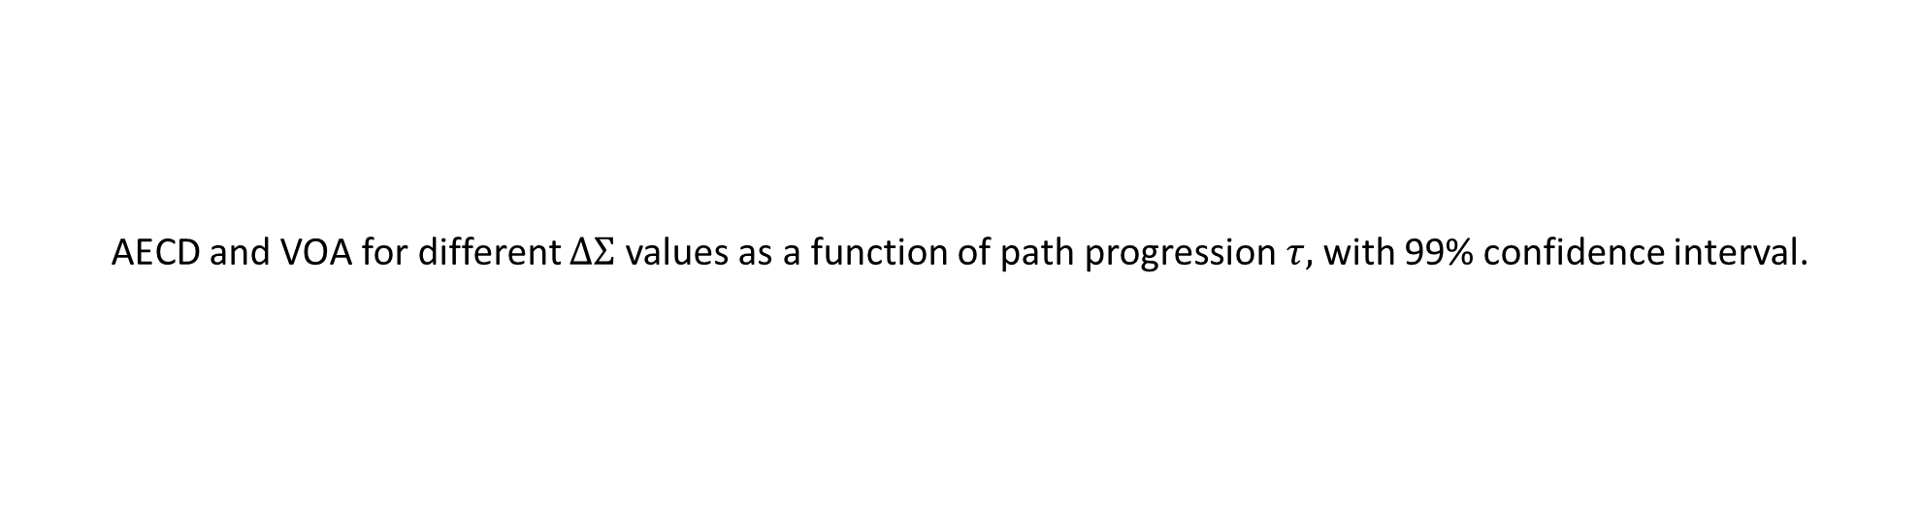
Simulation Results Relocation and Localization Assistance – A Single Map-Path Pair
AECD and VOA for different $ΔΣ$ values as a function of path progression $τ,$with 99% confidence interval.

Slide 8
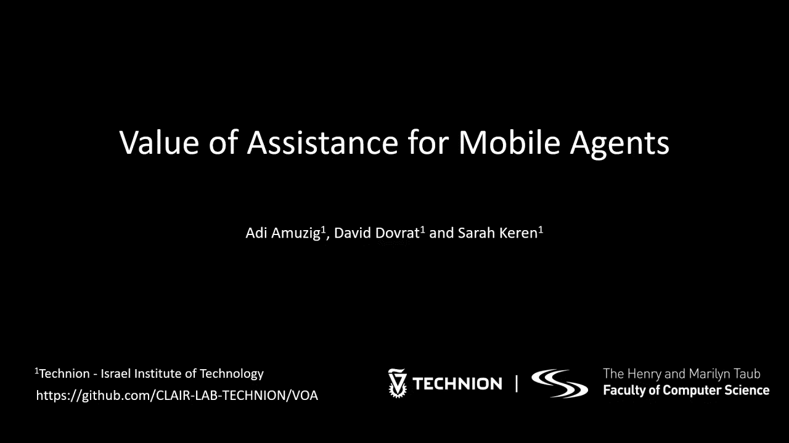

Slide 9
Contributions
Value of Assistance (VOA) for mobile autonomous agents :
no external sensors
localization uncertainty is modeled as a Gaussian process
Formalization of VOA for two forms of assistance:
relocation
localization
Empirically demonstration: VOA predicts the real value of assistance in both simulation and real-world robotic settings.
Notes:
When an agent is provided with relocation assistance at point 𝜏, it is moved from its actual location, denoted $Π^{E}\text{(}\text{τ}\text{)}$, to the corresponding point on the planned path, $Π^{P}(τ)$.

Slide 10
Notes:
Talk about what the orage means. It is the danger zone

